Slide 1
Issues in Professional practice
2012

Slide 2
ONLINE EVALUATIONS
Please evaluate the Course & the Instructor online
ASAP
It is important!!

Slide 3
Topics for Today
Conflict Resolution
Safety & Risk

Slide 4

Conflict Resolution
Compromise
Dealing with Conflict

Slide 5
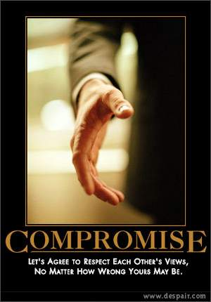
What is Compromise?
Positive connotation
  Involves finding agreement
  Spirit of mutual agreement between parties
  Flexibility to vary from stated goals
Negative connotation
  Sign of weakness in conviction
  Surrender of one’s objectives and principles

Slide 6
Is Making Compromises Ethical?
It depends...
Does making compromise involve betraying ethical principles?
Some compromises involve moral issues but some not so.

Slide 7
When does a compromise not involve ethics?
Individual agree on fundamental values but disagree on application
  Engineers agree on transparency in tendering but disagree on how to implement it
  Arrive at some middle course
Individuals disagree on the relative importance of two different values
  Engineers disagree on relative importance of safety vs. confidentiality.
  Create a synthetic position that addresses rival values

Slide 8
When does a compromise involve ethics?
When individuals disagree on the same fundamental value?
  Should we compromise on harassment?
  Is it ethical to ‘take’ money from the bank?
Making such a compromise betrays ones ethical principles and personal integrity.

Slide 9
Is it Ethical to ‘take’ money from a Bank?

Slide 10
Disagreements on fundamental values – when is it ok?
Yes, under some specific conditions.
  If there is a great degree of factual or conceptual uncertainty
  The moral issue has great complexity – there is no black/white answer.
  When there is a danger of breaking cooperative relationships – team, friends, or family.
  There is a non-deferrable decision – time constraint
  Limited resources require an imperfect decision – resource constraint.

Slide 11
Dealing With Conflict

Slide 12
Personal Modes of Handling Conflict
Individuals deal with conflict & disagreement very differently
Depends on
  Degree of concern about self - Assertiveness
  Degree to satisfy other’s concerns - Cooperativeness
Awareness about personal mode provides a pathway to resolve conflicts.

Slide 13
Five Modes of Conflict Handling
Competing
  Individual pursues self-interest at other person’s expense
Accomodating
  Neglects self-interest to consider other person’s needs
Avoiding
  Person avoids conflict situation and does not address it.
Collaborating
  Works with other person to find a solution to both persons
Compromising
  Partially satisfies both parties

Slide 14
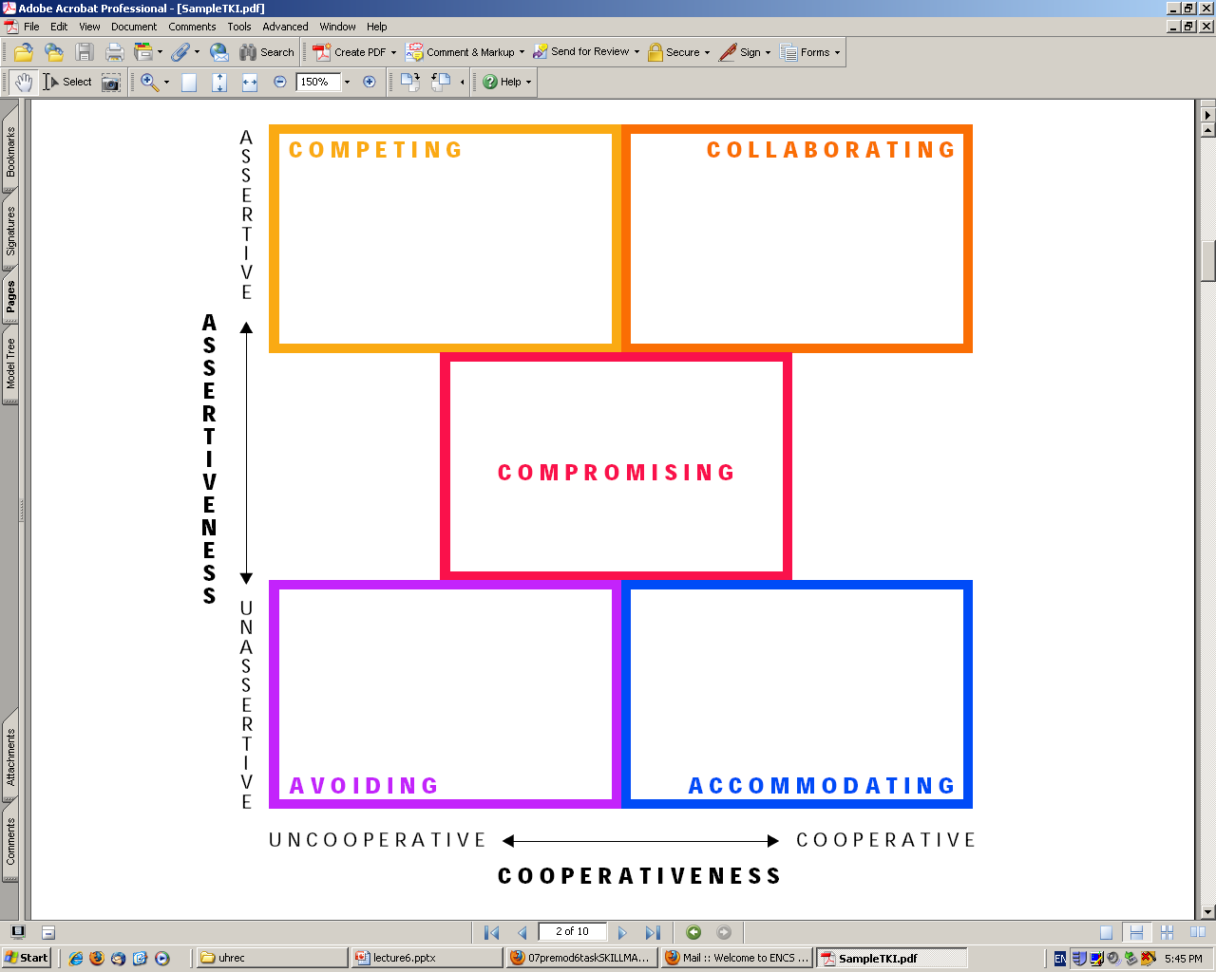
Conflict Handling Modes
5 Modes
Competing
Collaborating
Compromising
Avoiding
Accomodating

Slide 15
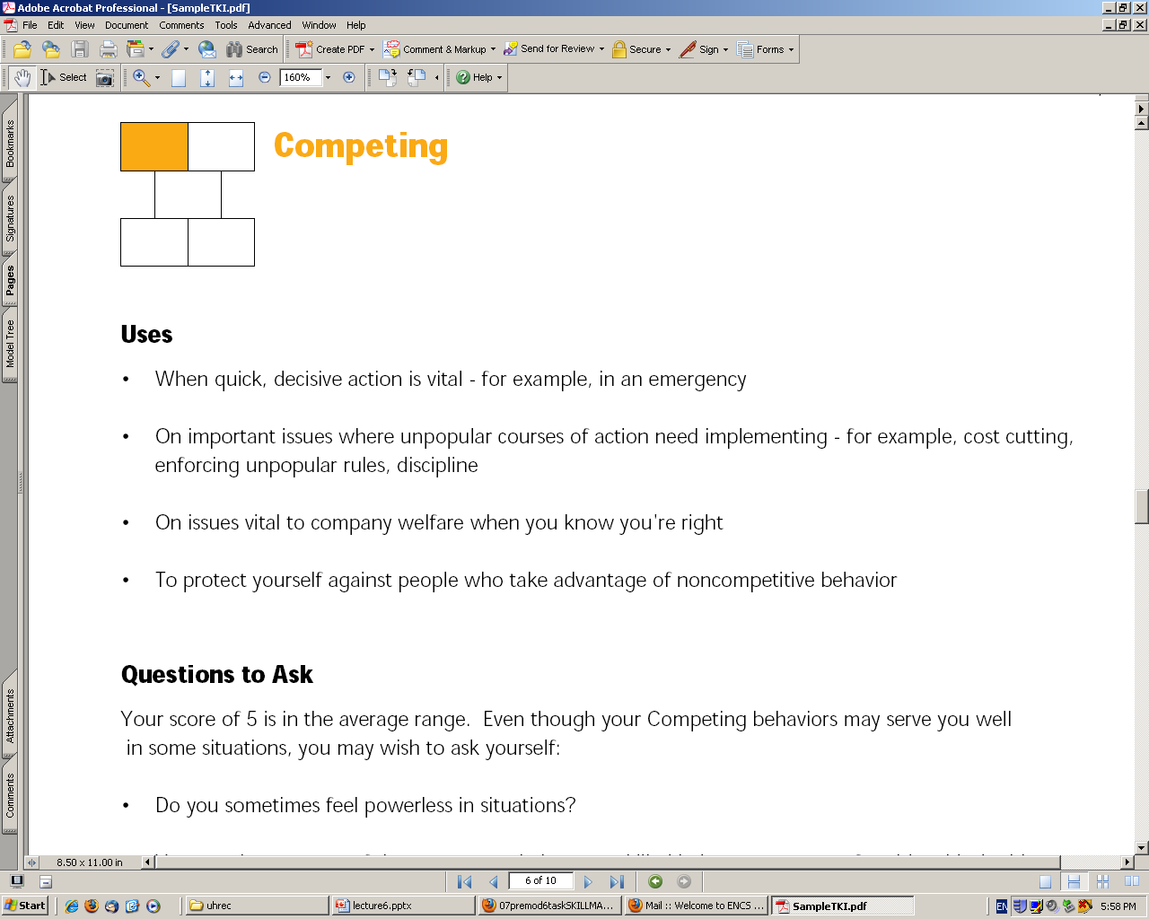
Competing

Slide 16
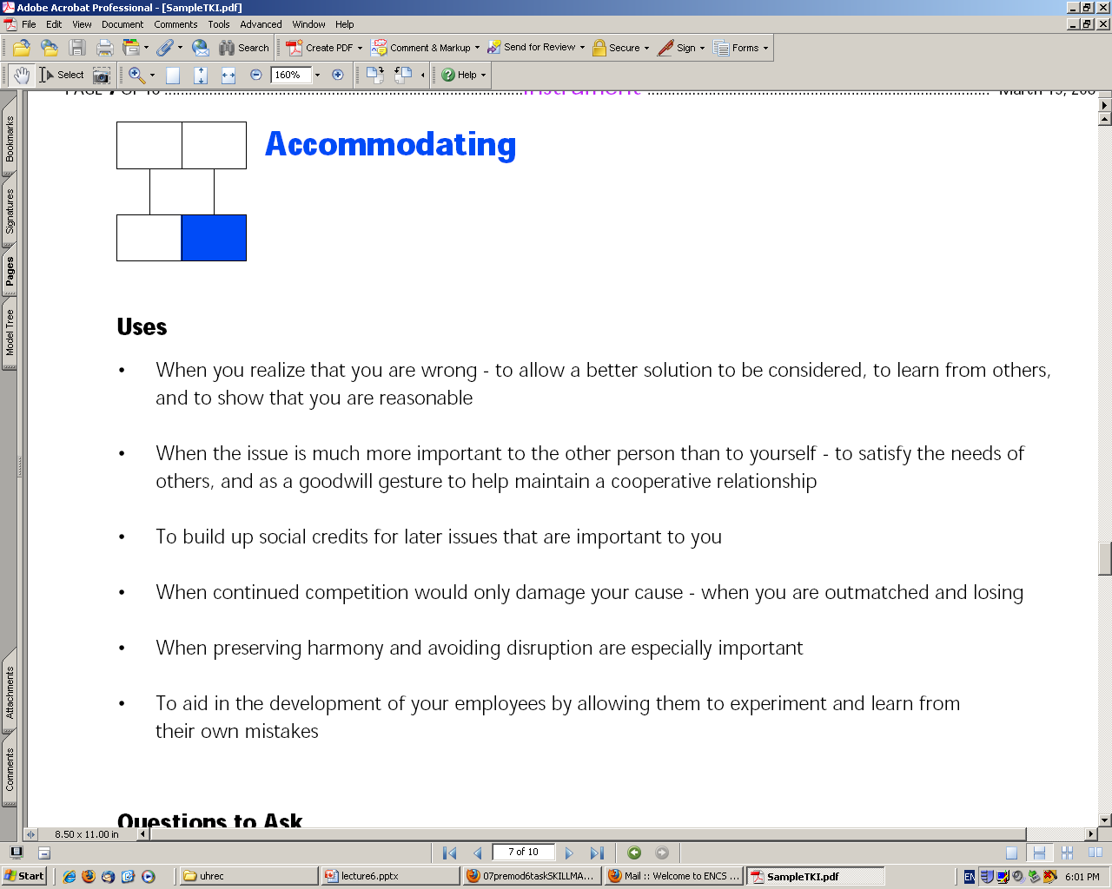

Slide 17
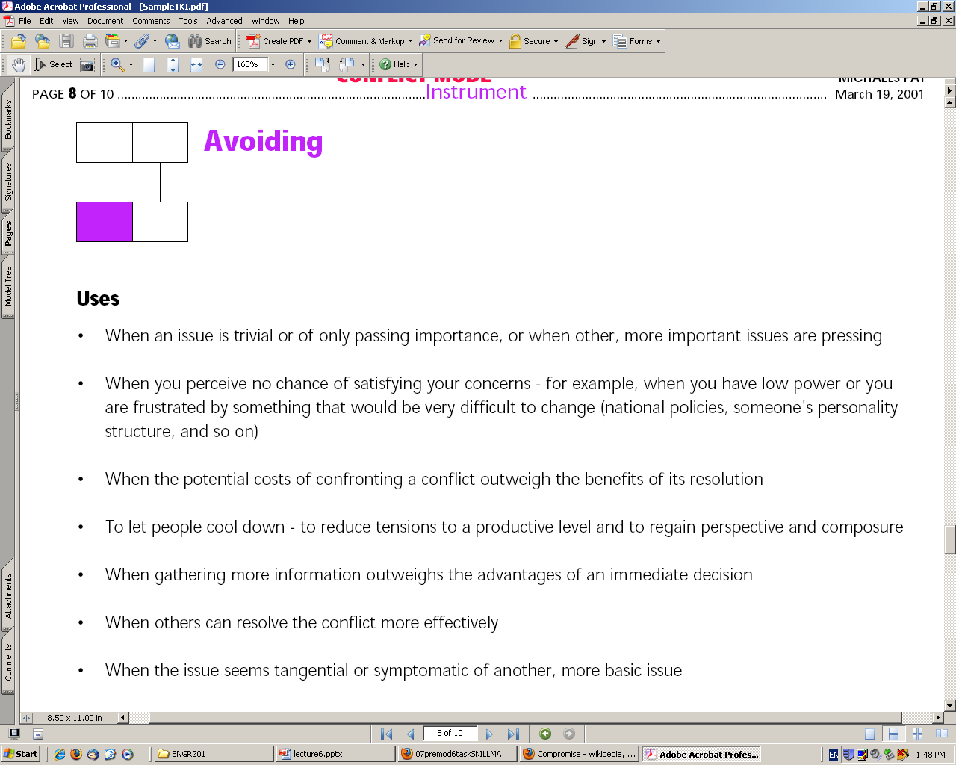
Avoiding Conflict

Slide 18
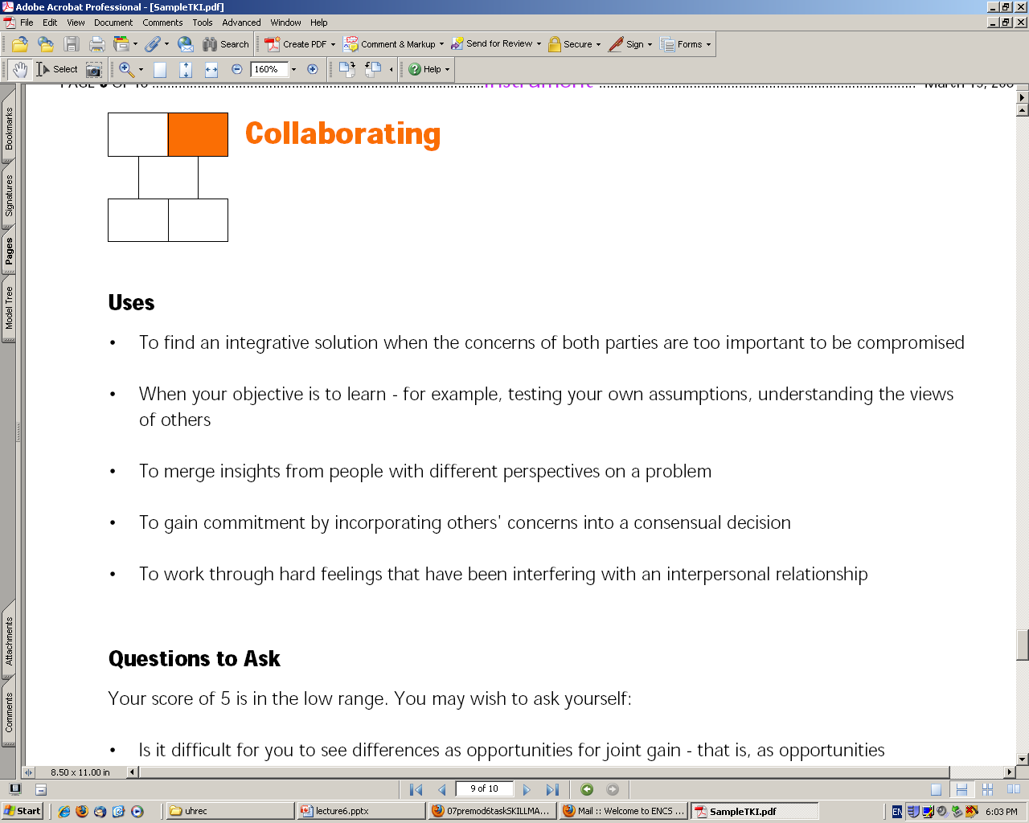

Slide 19
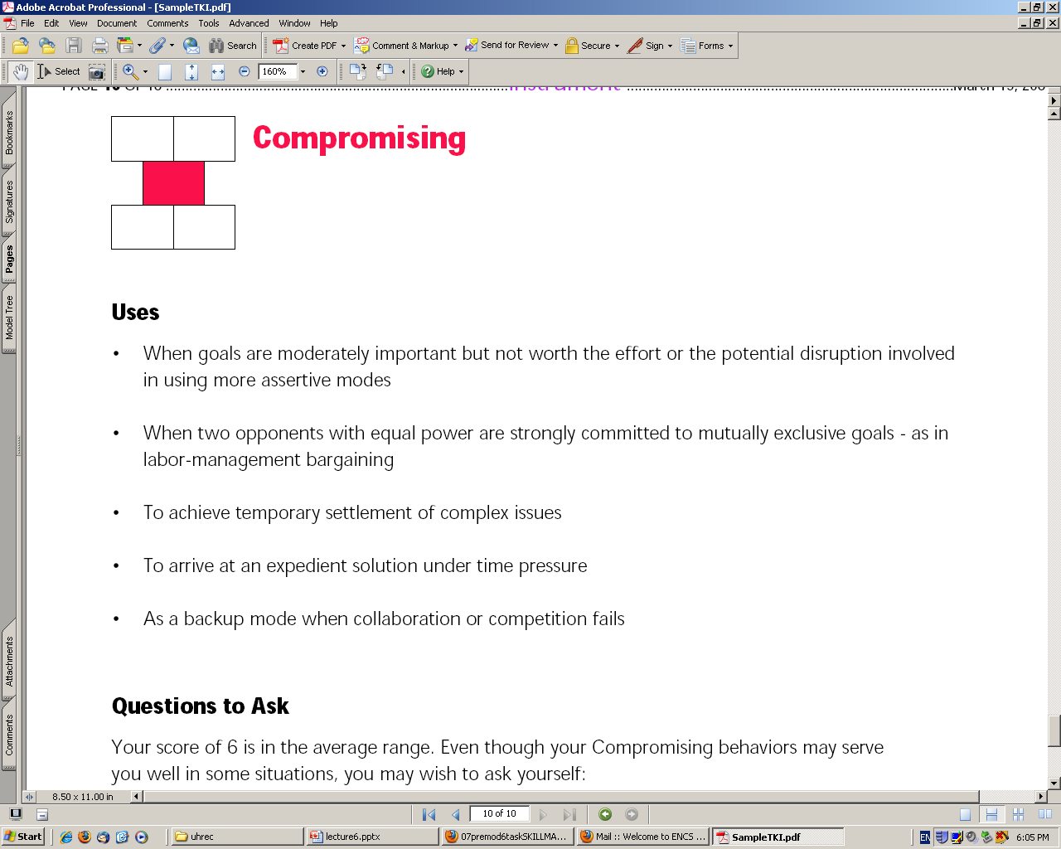

Slide 20
Safety, Risk & Public

Slide 21
Safety, Risk & the Public
Safety is the responsibility of Engineers
  Ensuring process and product safety
Analyze risk associated with product or process
Communicate risk transparently to clients or public
Acquire informed consent of participants.

Slide 22
What is risk? – some definitions
Risk: the probability of an event occurring and of the consequences of that event.
Risk Assessment: It is the determination of quantitative value of risk related to a recognized threat
Risk neutralization: The danger potential of a product or process may be reduced by safety measures
‘Zero risk’ does not exist

Slide 23
What is Risk Communication?
Risk Communication is the communication of risk associated with a technical product or process to the public.
It is the basis for getting consent from society for any product or process you want to introduce.

Slide 24
Risk Perception in society
It is the degree of sentiment of danger among individuals who are exposed to the source of risk. It varies depending on
  Is risk well known? Is it fair or evenly distributed?
  Is exposure voluntary
  Is there real possibility of catastrophy

Slide 25
How to communicate risk?
Must be issued by persons in charge and having information
All stakeholders must be identified and catered to
Delicate balanced operation – informed decision or hysteria

Slide 26
Informed Consent
Informed Consent – based on two aspects
  Providing Information
  Obtaining voluntary agreement
Disclosure Laws - information required by a “reasonable nontechnical person”
Voluntary consent is basis of liberal democracy

Slide 27
ONLINE EVALUATIONS
Please evaluate the Course & the Instructor online
ASAP
It is important!!

